Slide 1
Neural Networks
Lecture 15

Slide 2
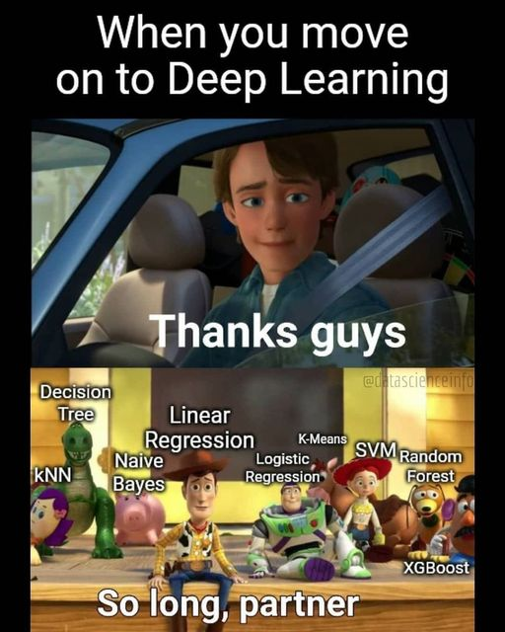
https://www.facebook.com/aimmediahouse/posts/tgisundaymoving-on-to-deeplearningmemes-memesdaily-memeoftheday-funartificialint/3413677738655320/

Slide 3
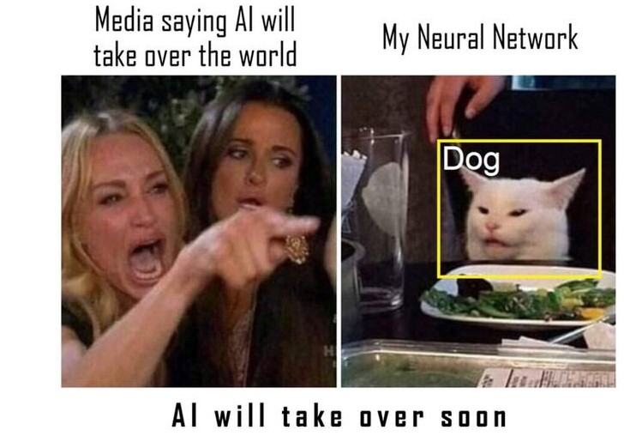
Neural Networks
It is September 2024
In this day and age, neural networks form the basis of the vast, enormous, and overwhelming majority of the discussion around AI
ChatGPT is a Neural Network
Midjourney is a Neural Network
The neural network family is a big one but they share a lot of the same underlying characteristics
We are going to start simple
https://techvangart.com/2023/04/06/ai-trends-the-greens-the-scams-and-talent-hunt/

Slide 4
Quick Question
How many have had a neural network or deep learning class before?

Slide 5
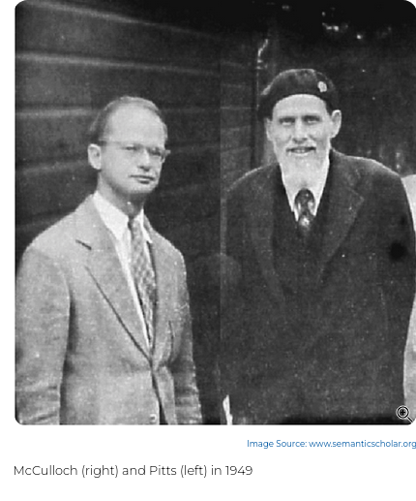
History of Neural Networks
Because, for some reason, it's illegal to start a neural network lecture without this slide
I think AI developers just get irritated when people think it's new
McCulloch and Pitts wrote on them in 1943
First multi-layered network in 1975
Neural Networks didn't really get popular until we made two important advancements
https://cs.stanford.edu/people/eroberts/courses/soco/projects/neural-networks/History/history1.html
https://www.historyofinformation.com/detail.php?entryid=782

Slide 6
History of Neural Networks
Because, for some reason, it's illegal to start a neural network lecture without this slide
I think AI developers just get irritated when people think it's new
McCulloch and Pitts wrote on them in 1943
First multi-layered network in 1975
Neural Networks didn't really get popular until we made two important advancements
  Much faster computing
https://cs.stanford.edu/people/eroberts/courses/soco/projects/neural-networks/History/history1.html
https://www.historyofinformation.com/detail.php?entryid=782

Slide 7
History of Neural Networks
Because, for some reason, it's illegal to start a neural network lecture without this slide
I think AI developers just get irritated when people think it's new
McCulloch and Pitts wrote on them in 1943
First multi-layered network in 1975
Neural Networks didn't really get popular until we made two important advancements
  Much faster computing
  Lots of data
https://cs.stanford.edu/people/eroberts/courses/soco/projects/neural-networks/History/history1.html
https://www.historyofinformation.com/detail.php?entryid=782

Slide 8
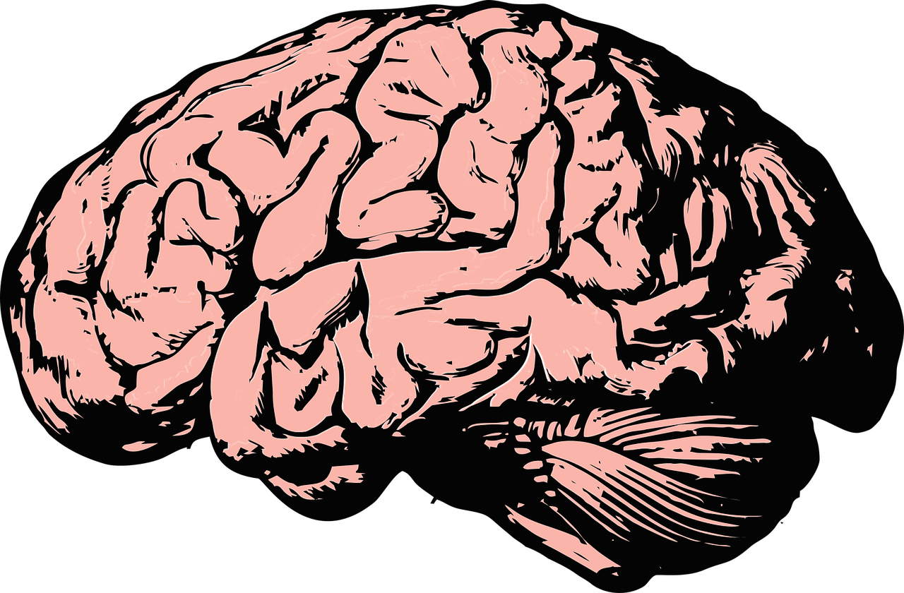
Inspiration behind Neural Networks
You brain
Hence "Neural"

Slide 9
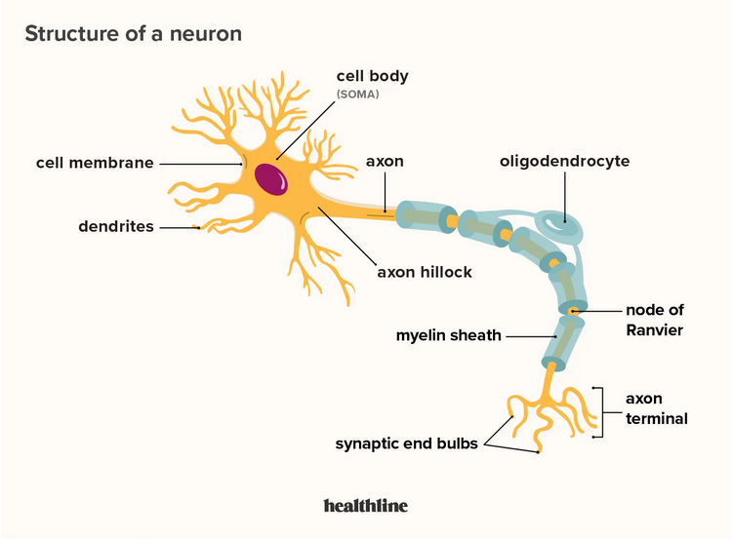
Neuron
https://www.healthline.com/health/neurons

Slide 10
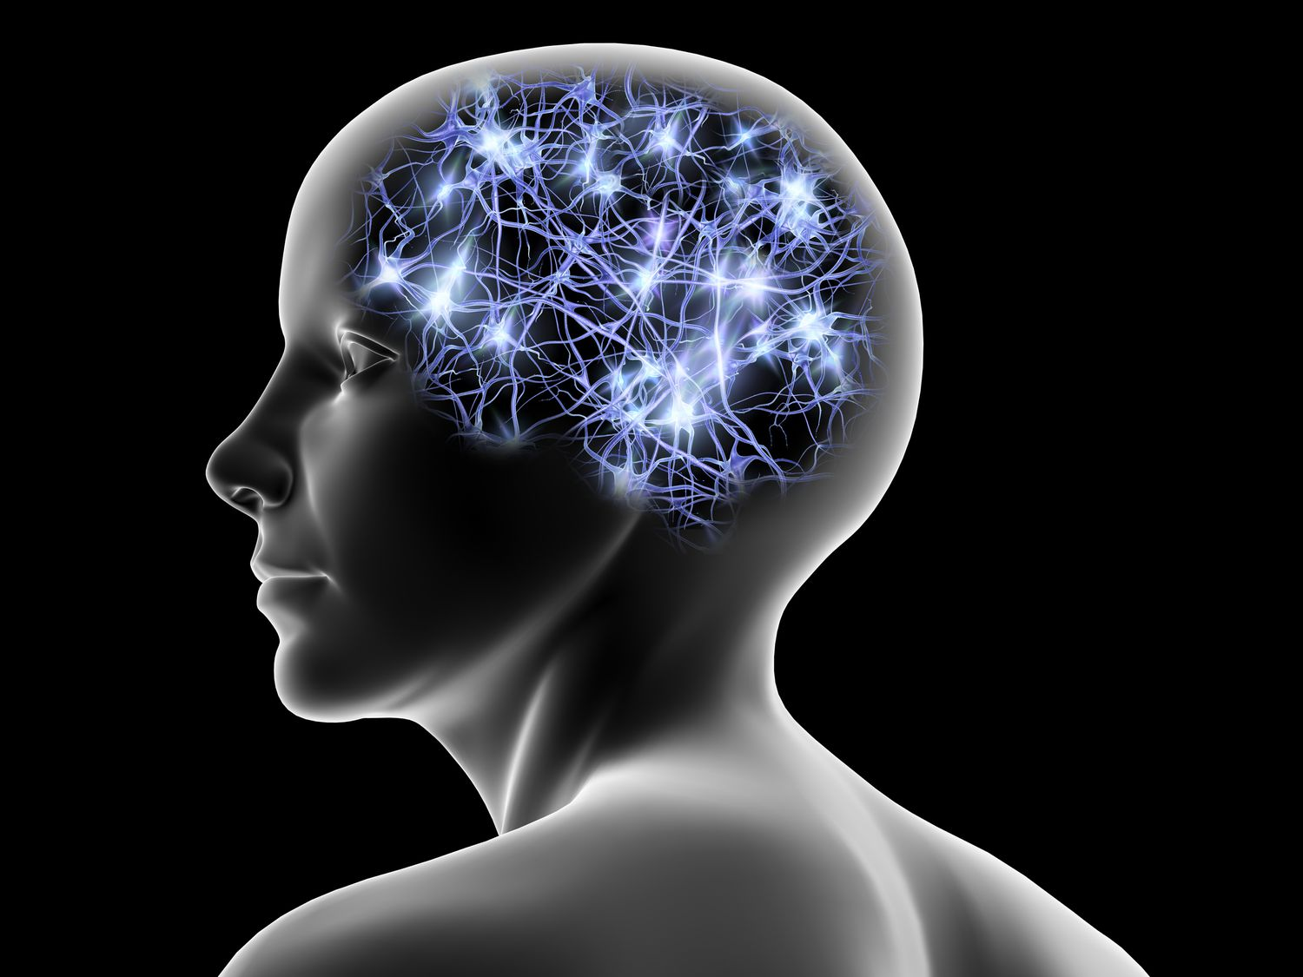
Neuron
Neuron sends messages to other neurons
Activate different parts of your nervous system
Your neural network is really responsible for you, how you think, how you move
Your neural network is concentrated in your brain, but is not completely limited to your brain
Spinal cord and nervous system as well
Not all of your cognition takes places in your brain
In octopuses, a lot takes places in their arms
https://www.lifewire.com/what-is-a-neural-network-5181580

Slide 11
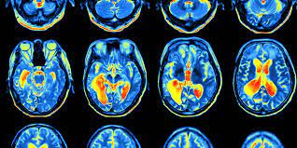
Your neural network
We know a fair amount about electrical activity in your brain
Fancy pictures
One zillion studies that talk about how something "lights up your brain"
Electrical activity related to the firing of different places in your neural network, different groups of neurons
Your brain is "plastic", neurons can change and die, and the connections between them can change over time
Studies suggest that the basic connections in your neural network are set in place pretty close to from birth
But the strength of the connections between them changes all throughout your life
https://www.eitrainingcompany.com/2017/05/reality-testing-and-learning-to-change-our-opinions/

Slide 12
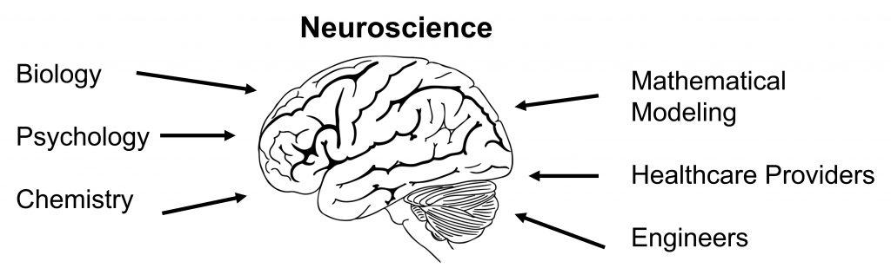
Neuroscience
Disclaimer: I am not a neuroscientist and most of my information is coming from research based on the AI-neuroscience connection
Neuroscience tries to study the ways we are wired and create understanding based on the wiring and firing of neurons
There are a lot of interesting things we can observe, and make conjectures based on observations
But a lot we just don't know much about
  No definitive answer on why you dream
  What causes your own inner monologue
https://openbooks.lib.msu.edu/introneuroscience1/chapter/what-is-neuroscience/

Slide 13
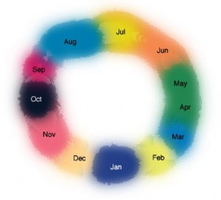
Neuroscience
But there are plenty of interesting observations we’ve made through neuroscience
Your neural network is highly interconnected
But also modular for tasks
We hypothesize the way it's wired can be responsible for different things:
  Mental disorders: Too connected within units, not connected enough between them
  Synesthesia: overconnected between sensory units
https://www.synesthesiatest.org/symptoms-of-synesthesia

Slide 14
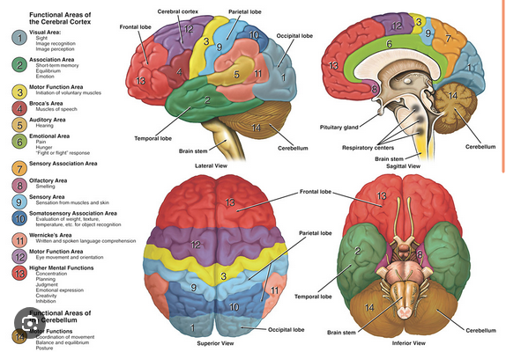
Architectures
Your brain has an interesting one
Your sensory integration is very interesting (vision, smell, etc)
https://dana.org/resources/neuroanatomy-the-basics/

Slide 15
Why Spend So Much Time Talking About Brains?
Because: neural networks model the hypothesized underlying biological principle

Slide 16
Why Spend So Much Time Talking About Brains?
Because: neural networks model the hypothesized underlying biological principle
Because: the model is highly imperfect (computer science is probably not very accurate to biology, and biology is more of a best-guess situation)

Slide 17
Why Spend So Much Time Talking About Brains?
Because: neural networks model the hypothesized underlying biological principle
Because: the model is highly imperfect (computer science is probably not very accurate to biology, and biology is more of a best-guess situation)
Because: We can use what we learn in both fields to help each other

Slide 18
Why Spend So Much Time Talking About Brains?
Because: neural networks model the hypothesized underlying biological principle
Because: the model is highly imperfect (computer science is probably not very accurate to biology, and biology is more of a best-guess situation)
Because: We can use what we learn in both fields to help each other
Because: AI comes with lots of ethical concerns and sooner or later you might have to weigh in on the AGI debate

Slide 19
Why Spend So Much Time Talking About Brains?
Because: neural networks model the hypothesized underlying biological principle
Because: the model is highly imperfect (computer science is probably not very accurate to biology, and biology is more of a best-guess situation)
Because: We can use what we learn in both fields to help each other
Because: AI comes with lots of ethical concerns and sooner or later you might have to weigh in on the AGI debate
Because: You are embodied, and AI available today is mostly not

Slide 20
Why Spend So Much Time Talking About Brains?
Because: neural networks model the hypothesized underlying biological principle
Because: the model is highly imperfect (computer science is probably not very accurate to biology, and biology is more of a best-guess situation)
Because: We can use what we learn in both fields to help each other
Because: AI comes with lots of ethical concerns and sooner or later you might have to weigh in on the AGI debate
Because: You are embodied, and AI available today is mostly not
Because: You are doing everything you're doing with less power than it takes to power a lightbulb

Slide 21

Brief Pause to Appreciate Your Brain
Low power, highly efficient
You can turn milkshakes into fast and accurate object detection
Your wiring is 100% unique to you

Slide 22
Ok
Let's talk about looking at this in a model

Slide 23
Base Unit of a Neural Network
Neuron

Slide 24
Neuron
Internal Parameters

Slide 25
Neuron
Internal Parameters
Input

Slide 26
Neuron
Internal Parameters
Input
Transformation Process

Slide 27
Neuron
Internal Parameters
Input
Output
Transformation Process

Slide 28
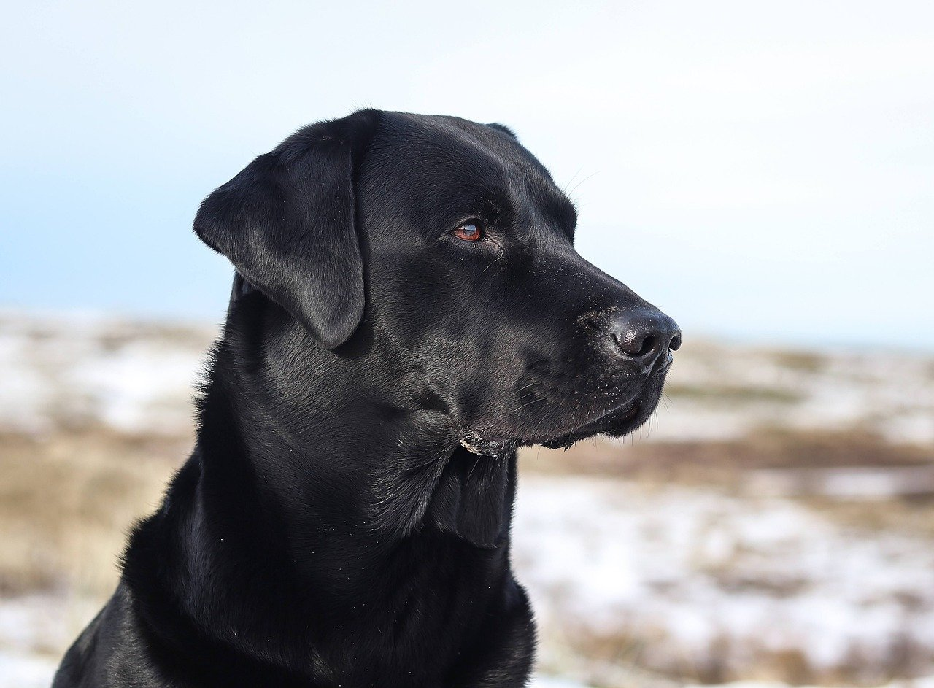
Multi Layer Perceptron
In this lecture we are going be going over a basic, but common neural network
If neural networks were dogs this one would be the labrador
Every so often for some reason it seems like they come up with another way to name this one
Multi-Layer Perceptron
Base Feed Forward Neural Network
Fully Connected Neural Network
Etc

Slide 29
Neural Networks
How are they structured?
How do they get their input?
How do they apply the transformation process?
Where does the output go?
What are the neurons internal parameters?
How do we evaluate a neural network?
How do we make it work well?

Slide 30
Structure of a Neural Network
Neurons are base unit
Neurons are arranged in layers
Layers as an organizing principle have to do with how the networks handles input/output
Layers can have any number of neurons
A neural network can have any number of layers
Layers, in general, receive the same input. Their output goes to the same layer.
Not all layers have to have the same number of neurons

Slide 31
Neuron

Slide 32
Neuron
Neuron
Neuron
Layer of 3 neurons

Slide 33
Neuron
Neuron
Neuron
Neuron
Neuron
Layer of 2 neurons
Layer of 3 neurons

Slide 34
Neuron
Neuron
Neuron
Neuron
Neuron
Neuron
Neuron
Layer of 2 neurons
Layer of 2 neurons
Layer of 3 neurons

Slide 35
3 Layer Neural Network
Neuron
Neuron
Neuron
Neuron
Neuron
Neuron
Neuron
Layer of 2 neurons
Layer of 2 neurons
Layer of 3 neurons

Slide 36
How do inputs and outputs work?
In a fully connected neural network, each layer gets input from the layer before it, and outputs to the next layer
The first layer gets input from your actual data
The last layer output is the overall network output or model prediction
Each neuron in a layer is connected to every other neuron in the layer before and every other neuron in the layer after,

Slide 37
Neural Networks
How are they structured? - DONE
How do they get their input?
How do they apply the transformation process?
Where does the output go?
What are the neurons internal parameters?
How do we evaluate a neural network?
How do we make it work well?

Slide 38
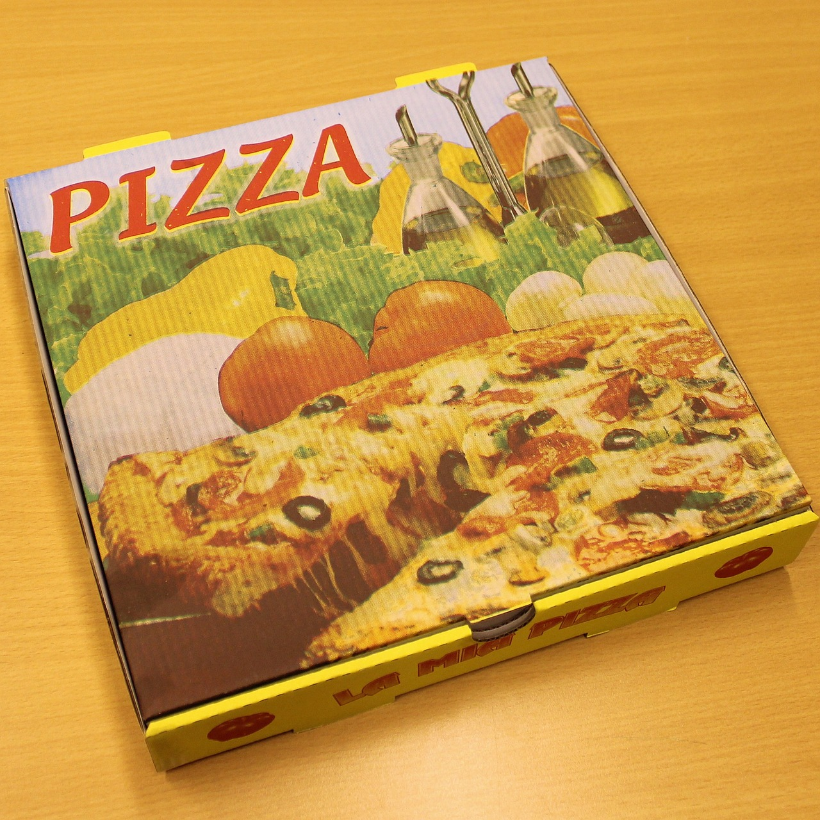
Easier to think about with an example
Pretend we are running a pizza delivery service
We are not allowed to open the pizza box
But we are naturally curious delivery people
We want to predict the type of pizza: pepperoni or cheese
And we have two variables: box weight and greasy percentage

Slide 39
Pizza Example
Two inputs:
  Box weight
  Greasiness %
One output with two possible values:
  Cheese
  Pepperoni
So, we want to construct a neural network to make this prediction based on the data we collected
Let's start with the first layer

Slide 40
Input
Layer 1
Box Weight
Greasiness %
Layer of 2 neurons

Slide 41
Input
Layer 1
Box Weight
I'm going to name this neuron Frank
Greasiness %
This neuron is named Helen
Layer of 2 neurons

Slide 42
Input
Layer 1
Box Weight
Frank
Greasiness %
Helen
Layer of 2 neurons
How do Frank and Helen get input?

Slide 43
Input
Layer 1
Frank and Helen both get both inputs
Frank gets to have the box weight and greasiness percentage
Helen gets to have the box weight and greasiness percentage
Box Weight
Frank
Greasiness %
Helen
Layer of 2 neurons

Slide 44
Input
Layer 1
Frank and Helen have different internal parameters
Based on their different internal parameters, they use the same input to generate different output
We will talk about the transformation they use to generate their output later
Box Weight
Frank
Greasiness %
Helen
Layer of 2 neurons

Slide 45
Input
Layer 1
Frank and Helen have different internal parameters
Based on their different internal parameters, they use the same input to generate different output
We will talk about the transformation they use to generate their output later
Box Weight
Frank
Frank's info
Greasiness %
Helen
Helen's info
Layer of 2 neurons

Slide 46
Input
Layer 1
Box Weight
Frank
Frank's info
Now what happens?
Greasiness %
Helen
Helen's info
Layer of 2 neurons

Slide 47
Input
Layer 1
Box Weight
Frank
Frank's info
Well, if we want, we can add another layer. Let's add a three neuron layer.
Greasiness %
Helen
Helen's info
Layer of 2 neurons

Slide 48
Input
Layer 1
Box Weight
Frank
Frank's info
Greasiness %
Helen
Helen's info
Layer of 2 neurons
Layer of 3 neurons

Slide 49
Input
Layer 1
This is Betty
Box Weight
Frank
Frank's info
This is Clint
Greasiness %
Helen
Helen's info
This is Emeril
Layer of 2 neurons
Layer of 3 neurons

Slide 50
Input
Layer 1
Betty
What do Betty, Clint, and Emeril get as input?
Box Weight
Frank
Frank's info
Clint
Greasiness %
Helen
Helen's info
Emeril
Layer of 2 neurons
Layer of 3 neurons

Slide 51
Input
Layer 1
What do Betty, Clint, and Emeril get as input?
The layer before them is Frank and Helen
Betty
Box Weight
Frank
Frank's info
Clint
Greasiness %
Helen
Helen's info
Emeril
Layer of 2 neurons
Layer of 3 neurons

Slide 52
Input
Layer 1
What do Betty, Clint, and Emeril get as input?
The layer before them is Frank and Helen
So they will get Frank and Helen's info (that layer's output) as input to their own layer
Betty
Box Weight
Frank
Frank's info
Clint
Greasiness %
Helen
Helen's info
Emeril
Layer of 2 neurons
Layer of 3 neurons

Slide 53
Input
Layer 1
Now that we have two layers, let's name the layers too so we can keep track of them
Frank and Helen are the master chef layer
Betty, Clint, and Emeril are the cardboard experts
Betty
Box Weight
Frank
Frank's info
Clint
Greasiness %
Helen
Helen's info
Emeril
Layer of 2 neurons
Layer of 3 neurons

Slide 54
Input
Layer 1
Now that we have two layers, let's name the layers too so we can keep track of them
Frank and Helen are the master chef layer
Betty, Clint, and Emeril are the cardboard experts
Betty
Box Weight
Frank
Frank's info
Clint
Greasiness %
Helen
Helen's info
Emeril
Master Chef Layer
Cardboard Experts

Slide 55
Layer 2
Input
Layer 1
The Master Chefs (Frank and Helen) get the raw input data
The Cardboard experts only get input from the Masters Chefs
But they all get the same information
Betty
Box Weight
Frank
Frank's info
Clint
Greasiness %
Helen
Helen's info
Emeril
Master Chef Layer
Cardboard Experts

Slide 56
Layer 2
Input
Layer 1
Betty gets Frank's info and Helen's info
Clint gets Frank's info and Helen's info
Emeril gets Franks's info and Helen's info
Betty
Box Weight
Frank
Frank's info
Clint
Greasiness %
Helen
Helen's info
Emeril
Master Chef Layer
Cardboard Experts

Slide 57
Layer 2
Input
Layer 1
Betty, Frank, and Emeril are getting the same input but are using their different internal parameters to generate different outputs
They are using an internal transformation to generate this info we will talk about later
Betty
Box Weight
Frank
Frank's info
Clint
Greasiness %
Helen
Helen's info
Emeril
Master Chef Layer
Cardboard Experts

Slide 58
Layer 2
Input
Layer 1
Betty
Betty's info
Box Weight
Frank
Frank's info
Clint
Clint's info
Greasiness %
Helen
Helen's info
Emeril
Emeril's info
Master Chef Layer
Cardboard Experts

Slide 59
Layer 2
Input
Layer 1
Betty
Betty's info
Box Weight
Frank
Frank's info
Clint
Clint's info
Greasiness %
Helen
Helen's info
Emeril
Emeril's info
Master Chef Layer
Cardboard Experts
Now what?

Slide 60
Layer 2
Layer 1
Betty
Betty's info
Input
Box Weight
Frank
Frank's info
Clint
Clint's info
Greasiness %
Helen
Helen's info
Emeril
Emeril's info
You decide you have enough neurons weighing in. You are going to add an output neuron.
Master Chef Layer
Cardboard Experts

Slide 61
Layer 2
I named him Dave
Layer 1
Betty
Betty's info
Input
Box Weight
Frank
Frank's info
Clint
Clint's info
Dave
Greasiness %
Helen
Helen's info
Emeril
Emeril's info
Deliveryman
Dave is a one-neuron layer who is going to decide if the pizza is pepperoni and cheese. He is an output layer. We’ll name is layer deliveryman
Master Chef Layer
Cardboard Experts

Slide 62
Layer 2
Layer 3
(Output)
Layer 1
Betty
Betty's info
Input
Box Weight
Frank
Frank's info
Clint
Clint's info
Dave
Greasiness %
Helen
Helen's info
Emeril
Emeril's info
Deliveryman
Dave is a layer ahead of the Cardboard Experts layer. His input is from Betty, Clint, and Emeril (their output)
Master Chef Layer
Cardboard Experts

Slide 63
Layer 2
Layer 3
(Output)
Layer 1
Betty
Betty's info
Input
Cheese
Or
Pepperoni
Box Weight
Frank
Frank's info
Clint
Clint's info
Dave
Greasiness %
Helen
Helen's info
Emeril
Emeril's info
Deliveryman
Dave uses his input and his internal parameters to generate an output. His output is whether the cheese is pizza or pepperoni. He gives us what we wanted to predict.
Master Chef Layer
Cardboard Experts

Slide 64
Let's go through an example
(Just on connectedness - we'll get to the transformation in a second)
You have a pizza come through
It's weight is 1 pound
It's greasiness % is 20.

Slide 65
Layer 2
Layer 3
(Output)
Layer 1
Betty
Betty's info
Input
Cheese
Or
Pepperoni
Box
Weight: 1
Frank
Frank's info
Clint
Clint's info
Dave
Greasiness
%: 20
Helen
Helen's info
Emeril
Emeril's info
Deliveryman
Master Chef Layer
First, Frank and Helen are both given the box weight number (1) and the greasiness % (20)
Cardboard Experts

Slide 66
Layer 2
Layer 3
(Output)
Layer 1
Betty
Betty's info
Input
Cheese
Or
Pepperoni
45
Box
Weight: 1
Frank
Frank's info
Clint
Clint's info
Dave
Greasiness
%: 20
27
Helen
Helen's info
Emeril
Emeril's info
Deliveryman
Master Chef Layer
Next, Frank and Helen use their expertise to generate new information. Frank comes up with the number 45 and Helen comes up with the number 27
Cardboard Experts

Slide 67
Layer 2
Layer 3
(Output)
101
Layer 1
Betty
Betty's info
Input
Cheese
Or
Pepperoni
45
Box
Weight: 1
Frank's info
0.3
Frank
Clint
Clint's info
Dave
Greasiness
%: 20
27
Helen
Helen's info
16
Emeril
Emeril's info
Deliveryman
Now, Betty gets the number 45 from Frank and the number 27 from Helen. She uses her own expertise to get the number 101.
Clint and Emeril use the same input to get the number 0.3 and 16.
Master Chef Layer
Cardboard Experts

Slide 68
Layer 2
Layer 3
(Output)
101
Layer 1
Betty
Betty's info
Input
Cheese
Or
Pepperoni
45
Box
Weight: 1
Frank's info
0.3
Frank
Clint
Clint's info
Dave
Greasiness
%: 20
27
Helen
Helen's info
16
Emeril
Emeril's info
Deliveryman
Master Chef Layer
Finally, Dave gets 101 from Betty, 0.3 from Clint, and 16 from Emeril. He uses this information to decide that it's a cheese pizza.
Cardboard Experts

Slide 69
Important Information
It's called a feed forward network, because the information goes forward layer by layer until you get an output
It's a big ol' game of extremely additive telephone
Each layer only gets the layer's information before it
  Only Frank and Helen see the raw data. They try to extract useful information from it
  Betty, Clint, and Emeril only get to see Frank and Helen's information. They have to use what they know about Frank and Helen and their own expertise to generate their information
  Dave only gets to see the information from Betty, Clint, and Emeril. He tried to use what he knows about these three as well as his own expertise to guess if it's cheese or pepperoni.

Slide 70
Important Information
We hope layers extract useful features. These are value-added information from the raw data
We hope each layer learns how to use the information it's given to extract more and more useful information
Eventually leading to a very useful prediction
We sort of assume each neuron has its own area of expertise, like it's focusing on one specific concept. What information its actually generating can get extremely abstract.

Slide 71
Neural Networks
How are they structured? - DONE
How do they get their input? - DONE
How do they apply the transformation process?
Where does the output go?
What are the neurons internal parameters?
How do we evaluate a neural network?
How do we make it work well?

Slide 72
How does the Neuron Create New Information from the Inputs?
Transformation Process
Theoretically, a neural network can model any underlying function with enough nodes and layers
But in order to do that, we need to allow the neural network to have components that are non-linear (activation function)
Neuron has the following internal parameters:
  Weights
  Bias
  Activation function
The weights and bias for a given neuron should be specific to that particular neuron.
The activation function isn't a value, it's a process. So the same activation function proces might be used for the same neurons in a layer or even across layers.
But the output of the neuron is based on the inputs, weights, and bias in combination put through the activation function
So output of neuron should be specific to that particular neuron.

Slide 73
Example
Let's look at Frank

Slide 74
Frank
Internal Parameters
Input
Output
Transformation Process

Slide 75
Pizza Box Weight
Greasiness %
Frank gets 2 inputs: Pizza Box weight and Greasiness %

Slide 76
Pizza Box Weight
Greasiness %
Frank has several internal parameters. One of these is weights.

Slide 77
c
Pizza Box Weight Weight
c
Pizza Box Weight
Weights
Greasiness % Weight
c
Greasiness %
Frank has same number of weights as inputs. In fact, each weight is assigned to a particular input

Slide 78
c
Pizza Box Weight Weight
c
Pizza Box Weight
Weights
Greasiness % Weight
c
Greasiness %
Frank's Bias
c
c
Bias
c
Frank also has an internal parameter called a bias. Frank only has one bias term.

Slide 79

https://en.wikipedia.org/wiki/Sigmoid_function
c
Pizza Box Weight Weight
c
Pizza Box Weight
Weights
Greasiness % Weight
c
Greasiness %
Frank's Bias
c
c
Bias
c
Frank uses an activation function called sigmoid: It's a process, not a value. He feeds this process a value and it gives him a different value.

Slide 80
https://en.wikipedia.org/wiki/Sigmoid_function
c
Pizza Box Weight Weight
c
Pizza Box Weight
Weights
Greasiness % Weight
c
Greasiness %
Frank's Bias
c
c
Bias
c
Frank now has everything he needs to make an output value (generate new information). He does this in a few steps.

Slide 81
https://en.wikipedia.org/wiki/Sigmoid_function
Pizza Box Weight Weight*Pizza Box Weight
Pizza Box Weight Weight
Pizza Box Weight
Greasiness % Weight
Greasiness % Weight * Greasiness Percent
Greasiness %
Frank's Bias
Frank multiples the weights by the inputs.

Slide 82
https://en.wikipedia.org/wiki/Sigmoid_function
Pizza Box Weight Weight*Pizza Box Weight
Pizza Box Weight Weight
Pizza Box Weight
Greasiness % Weight
Greasiness % Weight * Greasiness Percent
Greasiness %
Frank's Bias
2. Frank adds these numbers together.

Slide 83
https://en.wikipedia.org/wiki/Sigmoid_function
Pizza Box Weight Weight*Pizza Box Weight
Pizza Box Weight Weight
Pizza Box Weight
Greasiness % Weight
Greasiness % Weight * Greasiness Percent
Greasiness %
Frank's Bias
3. Frank adds the bias term
Frank's Bias

Slide 84
https://en.wikipedia.org/wiki/Sigmoid_function
Pizza Box Weight Weight
Pizza Box Weight
Activation
Greasiness % Weight
Greasiness %
Frank's Bias
4. This number creates Frank's weighted sum, or activation, term. It's a linear combination of inputs. To make a non-linear output, he must use the activation function.

Slide 85
https://en.wikipedia.org/wiki/Sigmoid_function
Pizza Box Weight Weight
Pizza Box Weight
Activation
Greasiness % Weight
Greasiness %
Output
Frank's Bias
4. Frank puts his weighted sum or activation though the activation function process. This spits out his output. This is Franks information.

Slide 86
Example
Pizza Box weight is 1
Greasiness % is 10
Frank's Pizza box weight weight is 2
Frank's greasiness % weight is 5
Frank's bias term is 6
Frank's activation function process of choice is Sigmoid

Slide 87
Example
Pizza Box weight is 1
Greasiness % is 10
Frank's Pizza box weight weight is 2
Frank's greasiness % weight is 5
Frank's bias term is 6
Frank's activation function process of choice is Sigmoid
Let's do weights*inputs first
Pizza box weight * pizza box weight weight
  1*2 = 2
Greasiness % * greasiness % weight
  10*5 = 50
Add these together
  2+50 = 52

Slide 88
Example
Pizza Box weight is 1
Greasiness % is 10
Frank's Pizza box weight weight is 2
Frank's greasiness % weight is 5
Frank's bias term is 6
Frank's activation function process of choice is Sigmoid
Now let's add the bias term to that number
  52 + 6 = 58
58 is our weighted sum
  Or activation
  Or dot product
  Or a lot of other labels. Why, data scientists??!!

Slide 89
Example
Pizza Box weight is 1
Greasiness % is 10
Frank's Pizza box weight weight is 2
Frank's greasiness % weight is 5
Frank's bias term is 6
Frank's activation function process of choice is Sigmoid
Now we are going to put that number through the sigmoid function
Sigmoid(58) = 1
(sigmoid contrains output between 0 and 1. Sigmoid is not the only activation function choice. In implementation, not always popular, but popular for examples. We'll see why later).
So Frank's output is 1.

Slide 90
Neural Network
Each node carries out the same transformation, but with different weights and bias terms
Neurons in different layers have different inputs
Neurons in the same layer have the same input, however

Slide 91
Layer 2
Layer 3
(Output)
101
Layer 1
Betty
Betty's info
Input
Cheese
Or
Pepperoni
45
Box
Weight: 1
Frank's info
0.3
Frank
Clint
Clint's info
Dave
Greasiness
%: 20
27
Helen
Helen's info
16
Emeril
Emeril's info
Deliveryman
Master Chef Layer
Cardboard Experts

Slide 92
Error
The output of the network was not necessarily correct
You can calculate the error of a network guess with any applicable error function
Lots of options – similar to our tabular data
However, turning the error into a better network is a whole process
We will talk about that next time!

Slide 93
Questions?

